Slide 1
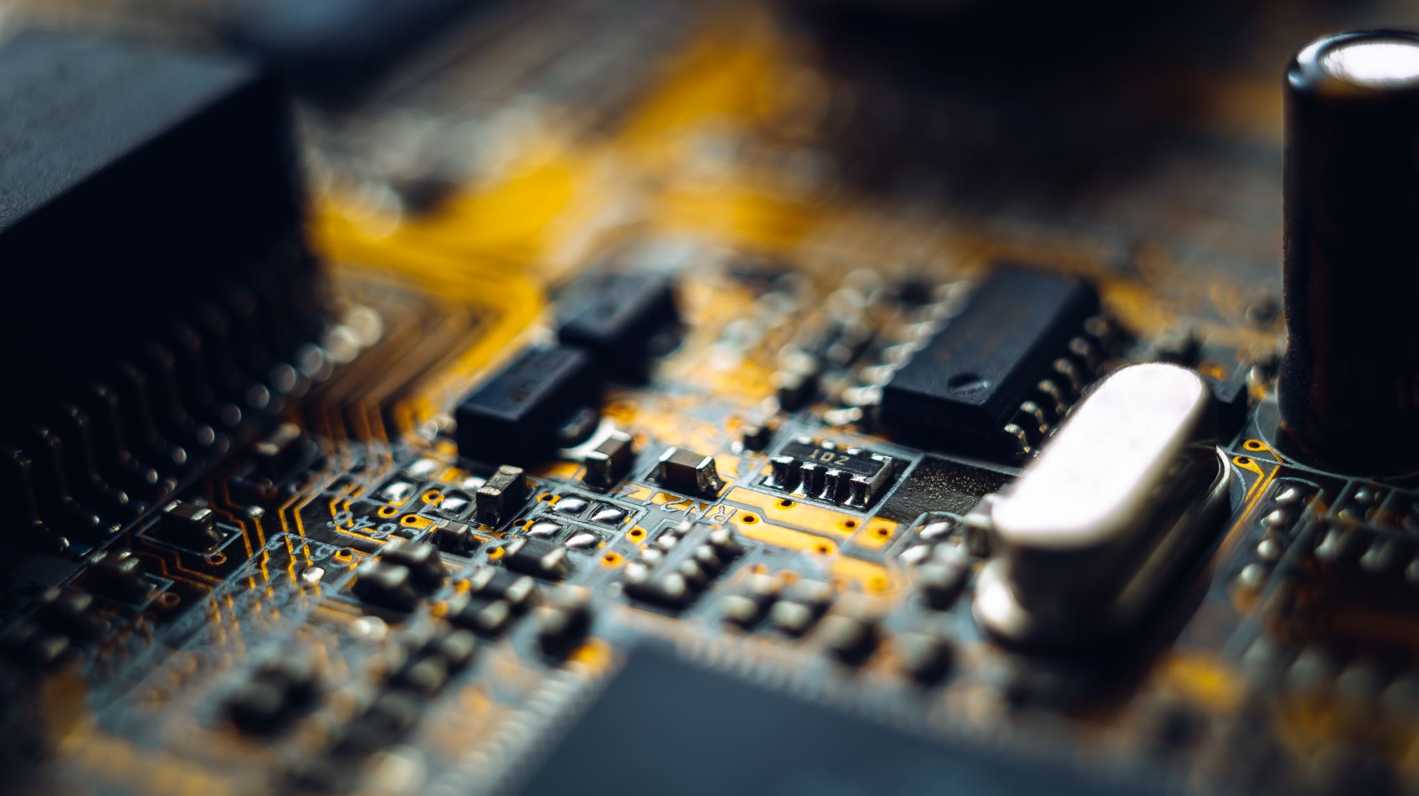
The three most dangerous things in the world are a programmer with a soldering iron, a hardware type with a program patch and a user with an idea.
Rick Cook

Slide 2
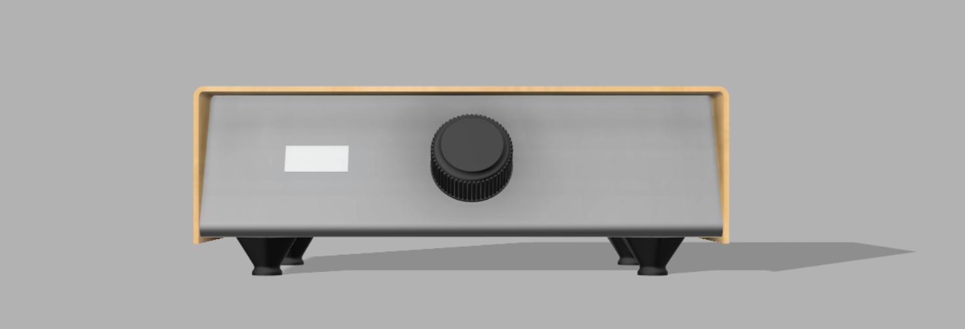

Creating a soldering station
Presented by Samy Warnants

Slide 3
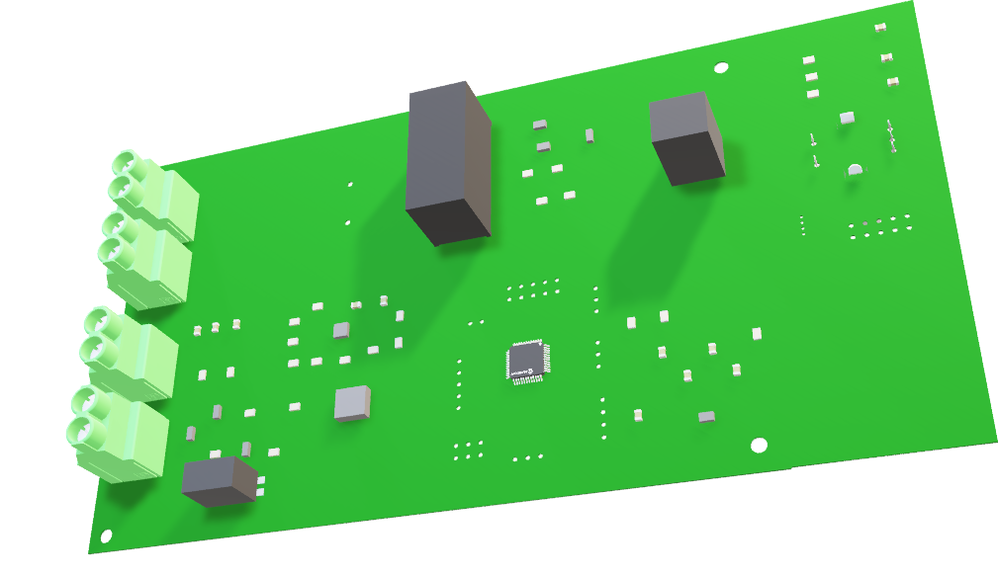
Table of contents
Introduction
How does it work?
Process summary
Problems
Conclusion
Sources

Slide 4
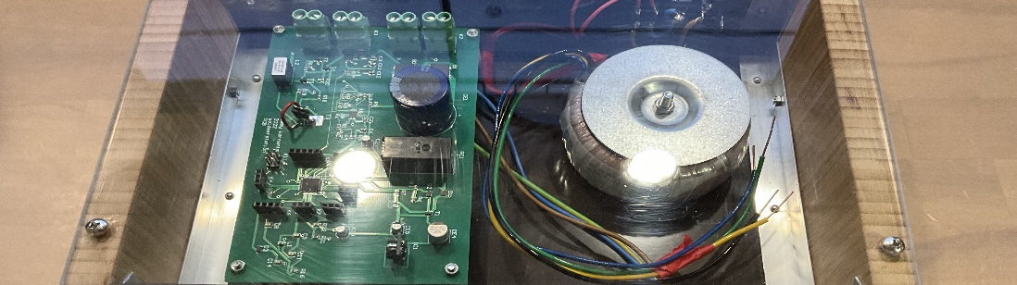
How does it work?
Connect the cables
Select soldering iron mode
Confirm selection
Set the temperature

Slide 5
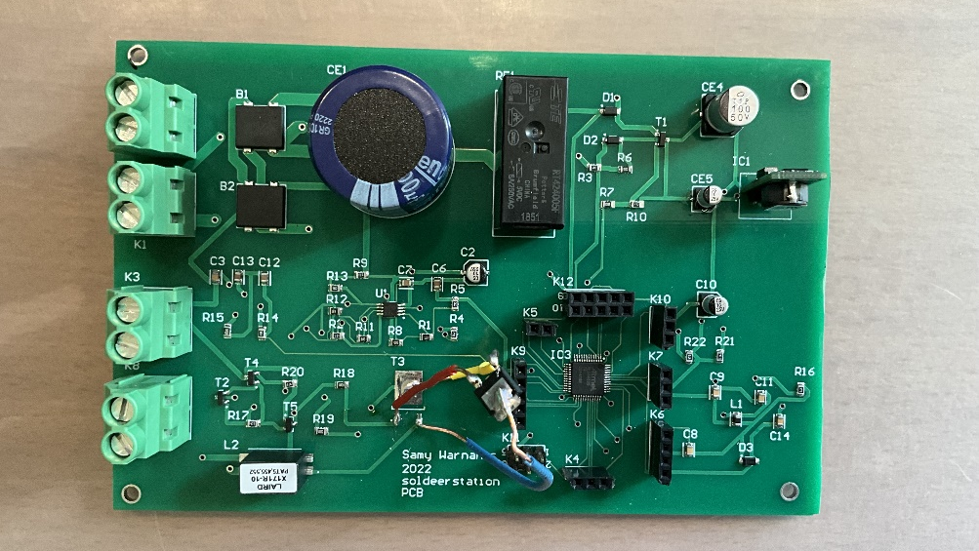
Process summary
Schematic creation
Component gathering
PCB
Case
Final assembly
Notes:
PCB = whole process behind the making of the PCB
Case = idem pcb

Slide 6
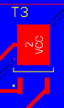
Problems
Misplaced mosfet
No 3D printer
3D print issues

Slide 7
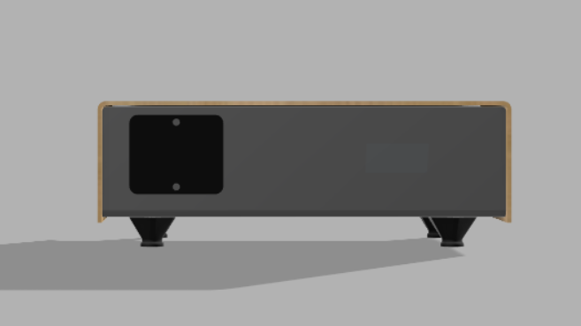
Conclusion

Slide 8
Sources
https://libquotes.com/rick-cook/quote/lbl1x9h

Slide 9
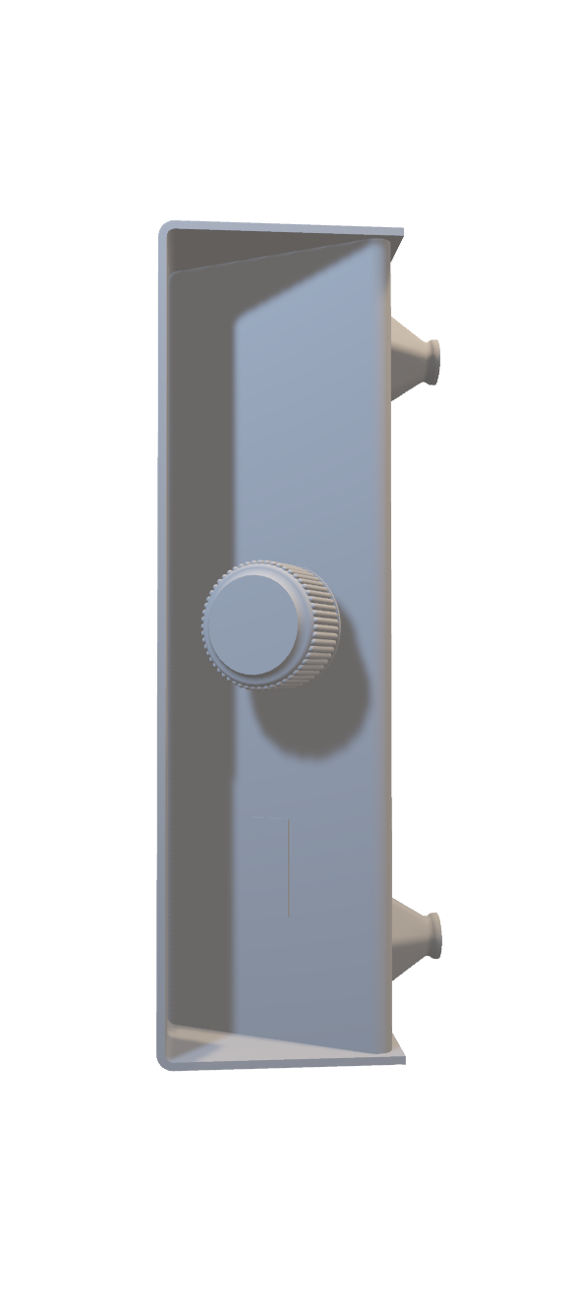
Purely as a showcase not with the PowerPoint

Slide 10
